Slide 1
Wahlzeit Design
Prof. Dr. Dirk Riehle
Friedrich-Alexander University Erlangen-Nürnberg
ADAP A04
Licensed under CC BY 4.0 International
Notes:
It is Friedrich-Alexander University Erlangen-Nürnberg – FAU, in short.
Corporate identity wants us to say “Friedrich-Alexander University”.

Slide 2
Overall Architectural Style
Servlet-based web application running on Google App Engine
Persistence is managed by GAE using “Cloud Datastore”
The architecture follows a typical model-view-separation style

Slide 3
“Physical” Architecture
Client (browser)
Application (application server)
Database (database server)

Slide 4
Application Architecture
User interface (view)
Domain model
Database access

Slide 5
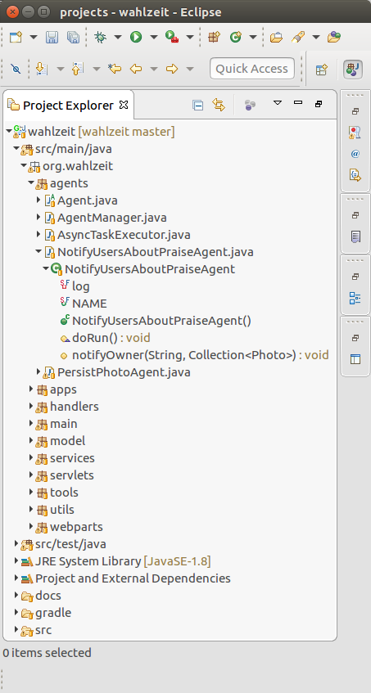
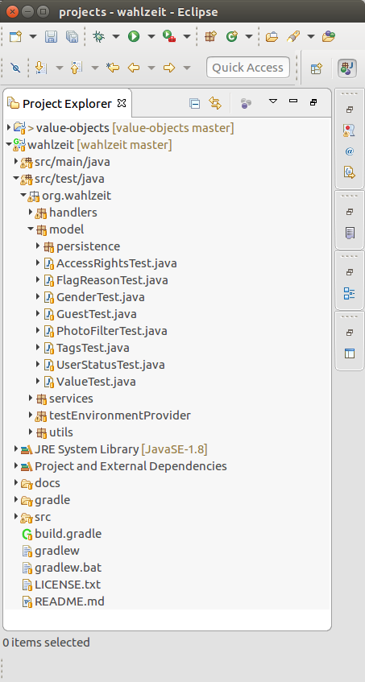
Code Organization / Architecture

Slide 6
Application Startup
Wahlzeit (org.wahlzeit.apps)
  A simple class hooked into the servlet container as listener
    Listens to initialized and destroyed events
    Delegates application startup and shutdown to Main class
Main (org.wahlzeit.main)
  A class hierarchy that handles system startup and shutdown
  ServiceMain represents the main web service application
    Starts-up all services; shuts them down upon request
  ScriptMain provides a single faceless startup/shutdown cycle
    Used to run scripts, for example, to migrate database schema

Slide 7
Application Startup Class Model

Slide 8
User Interaction
Servlets (org.wahlzeit.servlets)
  Default servlet handles static resource requests
  Main Wahlzeit servlet handles all dynamic content requests
    Has been configured with handlers per request type
    Dispatches request to proper handler
Handler (org.wahlzeit.handlers)
  One handler for each page type of the application
    Receives request information, performs handler-specific action
    Knows how to call the domain model

Slide 9
Web Page Generation
Handlers (org.wahlzeit.handlers)
  One handler for each page type of the application
    Is configured with a web page (HTML) template
    Requests templates and builds the web page
    Utilizes a UserSession for a user’s session state
WebParts and Templates (org.wahlzeit.webparts)
  A web-part is an object wrapping an HTML component
    Is generated from a web-part template
  All web-part templates are loaded from the file system
  The WebPartTemplateService provides those templates

Slide 10
Access Rights
Client (org.wahlzeit.model)
  Each visitor is represented by an object from the Client class hierarchy
    Has appropriate AccessRights associated with it
Handler (org.wahlzeit.handlers)
  Each handler knows about the current user by way of the UserSession
    Each access to a web page or a web-part is is checked against user rights

Slide 11
Domain Model
Domain abstractions (org.wahlzeit.model)
  Package contains all domain abstractions
    Client hierarchy for visitors, logged-in users, moderators, administrators
    Photo class hierarchy for photos
    PhotoCase for cases filed against photos (copyright violation etc)
    Various value object classes, e.g. language, status, gender
Manager (org.wahlzeit.model)
  An ObjectManager manages a particular domain abstraction (hierarchy)
    UserManager manages the User class hierarchy objects, etc.
  The object manager also hides the database access layer

Slide 12
(Part of) Domain Class Model

Slide 13
Object Persistence
Persistent (org.wahlzeit.services)
  Defines interface for reading and writing objects from storage
  Provides dirty flag to indicate that object needs to be saved
ObjectManager (org.wahlzeit.services)
  Manages DataObject (implements Persistent) instances
    One instance (of subclass) for each type of DataObject (subclass)
  Encapsulates storage layer access

Slide 14
System Configuration
SysConfig (org.wahlzeit.services)
  A key/value store with basic system configuration data
    Provides key directories and URLs
ModelConfig (org.wahlzeit.model)
  A key/value store with model configuration information
    Loaded from properties file
    One for each language (currently only ‘en’ and ‘de’)
    Provides language-specific text message formatting
ConfigDir (org.wahlzeit.services)
  Directory abstraction that provides custom extension mechanism

Slide 15
Session Management
Session (org.wahlzeit.services)
  A session object maintains one database connection
  For each active thread, one session object will be active
  Session objects get allocated when thread becomes active
SysSession (org.wahlzeit.services)
  A session associated with faceless system threads
UserSession (org.wahlzeit.services)
  A session associated with each currently active user
  Maintains user’s session state, e.g. form input data

Slide 16
Information Logging
LogBuilder (org.wahlzeit.services)
  A simple logging class that utilizes GAE logging

Slide 17
Email Sending
EmailService (org.wahlzeit.services.mailing)
  Provides interface for sending email, various implementations:
    SmtpEmailService actually sends email
    LoggingEmailService wraps email service and logs before sending
    MockEmailService drops any request; needed for testing
EmailServiceManager (org.wahlzeit.services.mailing)
  Provides global email service instance
  Can be configured for different execution scenarios (testing vs production)

Slide 18
System Agents
Agent (org.wahlzeit.agents)
  An agent is a thread performing some faceless system functionality
    Runs in the background, sleeps most of the time
AgentManager (org.wahlzeit.agents)
  Manages available agents, wakes them up

Slide 19
Photo Praise Notification
PraisePhotoFormHandler (org.wahlzeit.handlers)
  If a photo owner requested praise notification, enqueues praise with agent
NotifyAboutPraiseAgent (org.wahlzeit.agents)
  Agent enqueues praise requests received from handler
    Sends out praise information in regular intervals

Slide 20
Application Shutdown
ShowAdminPageHandler (org.wahlzeit.handlers)
  Administrators can request system shutdown
  Handler will request ServiceMain to shut down
Wahlzeit (org.wahlzeit.apps)
  Listens to servlet container
  Upon destroyed event, tells ServiceMain to shut down
ServiceMain (org.wahlzeit.main)
  Saves objects, closes database connections upon request

Slide 21
Extending Wahlzeit
Photo and PhotoFactory
  At a minimum, these classes need to be extended for your domain
Wahlzeit application startup
  In addition, you need to create instances of your photo factory

Slide 22
(Part of) Extending Wahlzeit Class Model

Slide 23
Some Known Shortcomings
User interface handling is simple but incomprehensible :-(
A few too many singletons; can and should be simplified
For more, see https://github.com/dirkriehle/wahlzeit/issues

Slide 24
Thank you! Questions?
dirk.riehle@fau.de – http://osr.cs.fau.de
dirk@riehle.org – http://dirkriehle.com – @dirkriehle
DR

Slide 25
Credits and License
Original version
  © 2012-2019 Dirk Riehle, some rights reserved
  Licensed under Creative Commons Attribution 4.0 International License
Contributions
  ...

